Slide 1
Genesis 1:1-31; 2:1-4
With the Creation Windows from the nave of Cairns cathedral.
REVISED NEW JERULSALEM BIBLE 2019

Slide 2
The First Day
From Darkness to Light

Slide 3
Genesis 1:1-5 (RNJB)
In the beginning, God created heaven and earth. Now the earth was formless void, there was darkness was over the deep, with the Spirit of God sweeping over the waters. God said ‘Let there be light’, and there was light.
God saw that light was good, and God separated light from darkness. God called light ‘day’, and darkness he called ‘night’.
And there was evening, and morning - the first day.

Slide 4
The Second Day
Sky, Sea & Earth

Slide 5
Genesis 1:6-11 (RNJB)
God said, ‘Let there be a dome in the midst of the waters to divide the waters in two.’ And so it was, God made the dome and it divided the waters under the dome from the waters above the dome. God called the dome ‘sky.’
And there was evening, and morning- the second day.
God said, ‘Let the waters under the sky come together into a single mass, and let dry land appear.’ And so it was.
God called the dry land ‘earth,’ and the mass of waters ‘seas.’
And God saw that it was good.

Slide 6
The Third Day
Plants, Seeds
& Fruit

Slide 7
Genesis 1:11-13 (RNJB)
God said, ‘Let the earth produce vegetation : seed-bearing plants, and fruit trees on earth, each bearing fruit of its own kind within it.’
And so it was.
The earth produced vegetation: the various kinds of seed-bearing plants and the fruit trees, each bearing fruit of its own kind within it.
God saw that it was good.
And there was evening and morning, the third day.

Slide 8
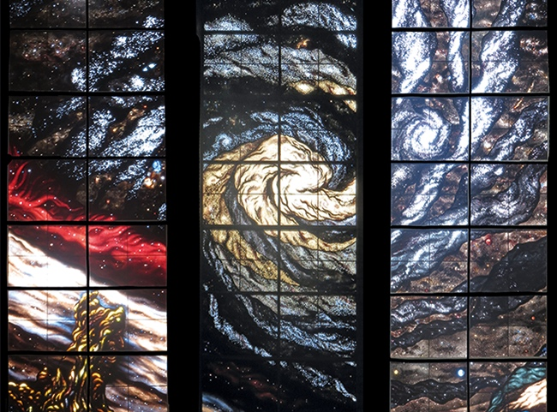
The Fourth Day
Sun, Moon
& Stars

Slide 9
Genesis 1:14-19 (RNJB)
God said ‘Let there be lights in the dome of heaven to separate day from night, and let them be signs for festivals, days and years. Let them be lights in the dome of heaven to give light on the earth.’
And so it was.
God made the two great lights: the greater light to rule the day, the smaller light to rule the night, and the stars. God set them in the dome of heaven to give light on the earth, to rule the day and the night and to separate light from darkness.
God saw that it was good. And there was evening and morning, the fourth day.

Slide 10
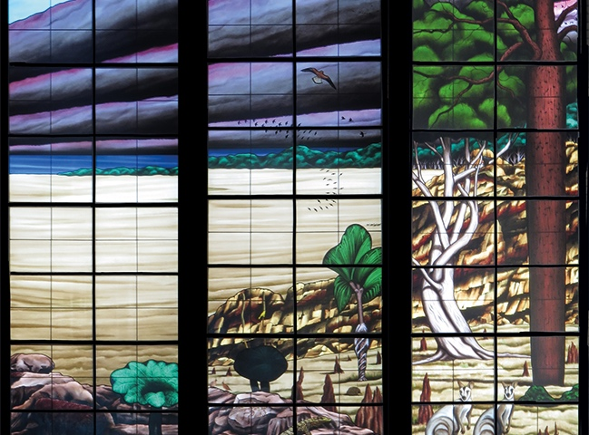
The Fifth Day
Living Creatures, Fish & Birds

Slide 11
Genesis 1:20-23 (RNJB)
God said, ‘Let the waters teem with living creatures, and let birds wing their way above the earth across the dome of heaven.’ And so it was. God created great sea monsters and all the creatures of every kind that glide and teem in the waters, and winged birds of every kind.
God saw that it was good.
God blessed them, saying, ‘Be fruitful, multiply and fill the waters of the seas; and let the birds multiply on land.’ And there was evening and morning, the fifth day.

Slide 12
The Sixth Day
Wild animals,
Livestock

Slide 13
Genesis 1:24-31 (RNJB)
God said, ‘Let the earth produce living creatures of every kind; cattle, creeping things and wild animals of every kind, and cattle in theirs, and all creatures that creep along the earth in their own kind.’ God saw that it was good.
God said, ‘Let us make man in our own image, in the likeness of ourselves, and let them be masters of the fish of the sea, the birds of heaven, the cattle, all the wild animals and all the creatures that creep along the earth.’
God created man in the image of himself,
in the image of God he created him,
male and female he created them.

Slide 14
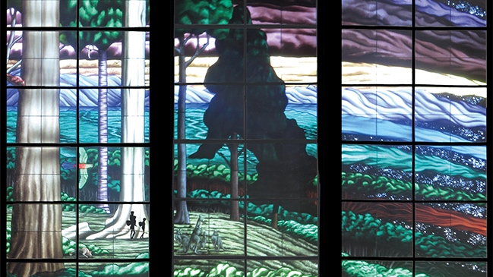
The Sixth Day continued
Men and women
caring for all that has been created

Slide 15
Genesis 1:24-31 (RNJB) continued
God blessed them, saying to them, ’Be fruitful, multiply, and fill the earth and subdue it. Be masters of the fish of the sea, the birds of heaven, and all the creatures that move along the earth.’
God also said, ‘Look, to you I give all the seed-bearing plants on the surface of the earth, and all the trees with seed-bearing fruit; this will be your food. And to all the wild animals all the birds of heaven and all the living creatures that creep along the ground, I give all the foliage of the plants as their food.’
And so it was.
God saw all he had made, and indeed it was very good. And there was evening, and morning, the sixth day.

Slide 16
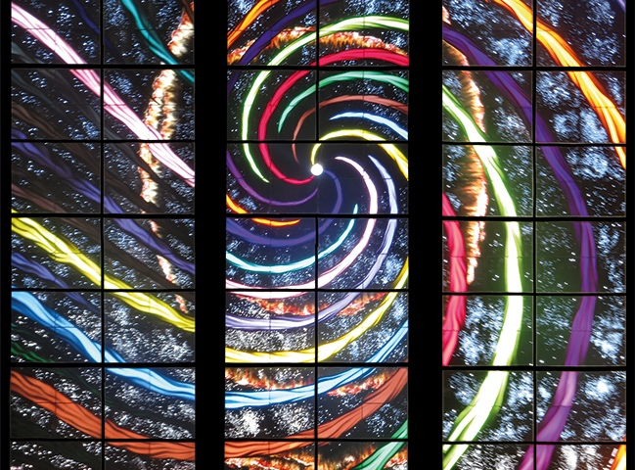
The Seventh Day
A Holy Time of Blessing & Rest

Slide 17
Genesis 2:1-4 (RNJB)
Thus the heavens and the earth were completed, and all their array. On the seventh day God completed the work he had done. He rested on the seventh day after all the work he had been doing.
God blessed the seventh day and made it holy, because on the day he rested after all his work of creating.
Such was the origin of heaven and the earth when they were created.

Slide 18
THANK YOU
Thanks to Glen McCullough for providing the images of the Creation used in this presentation.

